Slide 1

APPLICATIONS OF DATA SCIENCE: Appreciating Letters from Grandma Kelly Jones | June 2018
Notes:
0:00 My name is Kelly Jones and I’m here today to tell you about my grandmother. Grandma Jones was my first and best pen pal, but she’d been writing letters since long before I came along. Since she passed away three years ago, I’ve had a box of letters in my apartment that she wrote in the 40s, 50s, and 60s, and now I am finally putting that box to good use. Those letters are my dataset.

Slide 2
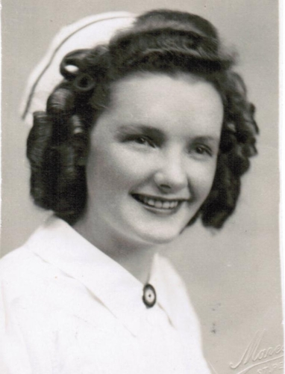
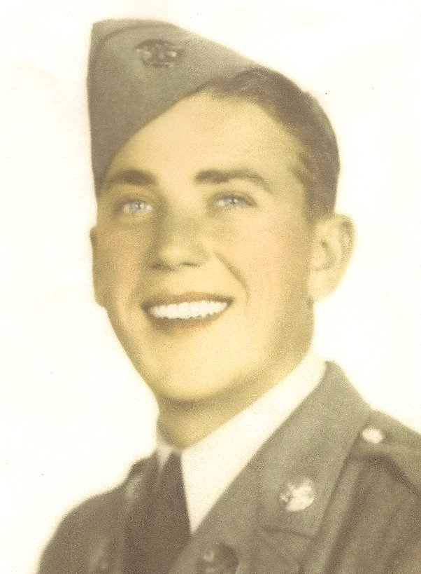


65 years
30+ moves
Elizabeth “Betty” Jones
1923 – 2015
Frank “Mutt” Jones
1919 – 2012
Notes:
0:30 First, a quick introduction. My grandparents were married for 65 years and thanks to Grandpa’s Air Force duties, they moved more than 30 times, most of those during the first half of their marriage while their family grew to five kids. Because my Grandma Jones was a social person and the telephone was not yet ubiquitous, she kept up with her family through letter-writing, no matter where they happened to be stationed. And they were stationed all over the country and world, so my first instinct with this dataset was to map it.

Slide 3
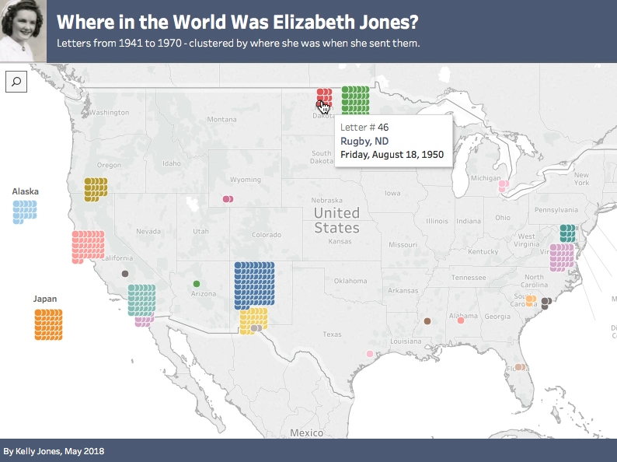
Notes:
1:00 These are the locations from which Grandma Jones sent her 362 letters, starting with her hometown of Rugby, North Dakota. Each dot is one letter, jittered around a point where they lived, and you can hover over dots to see the dates. The big blue cluster is Kirtland AFB in Albuquerque, which is the place from which she sent the most letters.

Slide 4
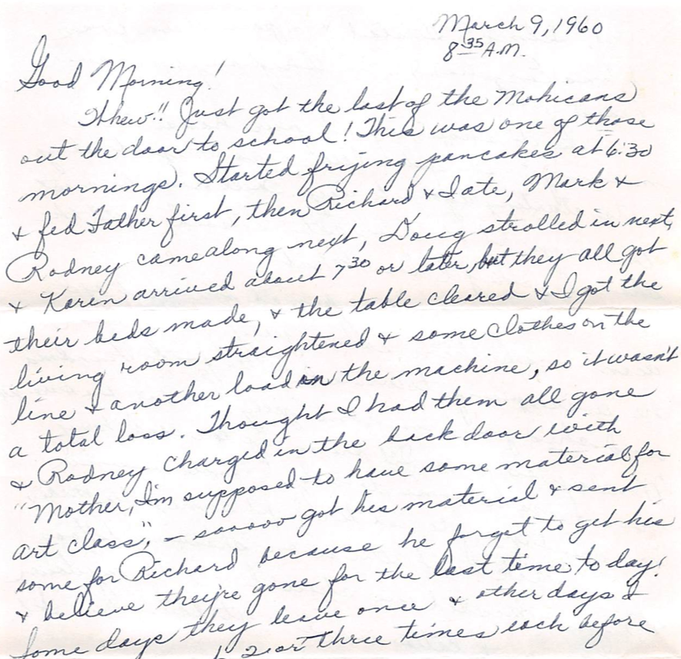
Challenges
Any objections if I take a couple days off while I’m home and increase our family?? If so, just say so and I’ll wait till next year to have “it”!
- June 16, 1950, while 7 months pregnant
Machines struggle with cursive
Humor doesn’t always translate
Notes:
1:30 But the metadata was the easy part. There were two key challenges with this dataset: 1) creative language not always easy for a machine to parse, esp. humor and sarcasm; and 2) actual transcription from cursive

Slide 5
Sentiment Analysis
Letter Recommender
Polarity is scored -1 to 1 (0 is neutral)
All letters but one were positive!
tf-idf: Finds 3 most similar letters based on important words
Notes:
2:00

Slide 6

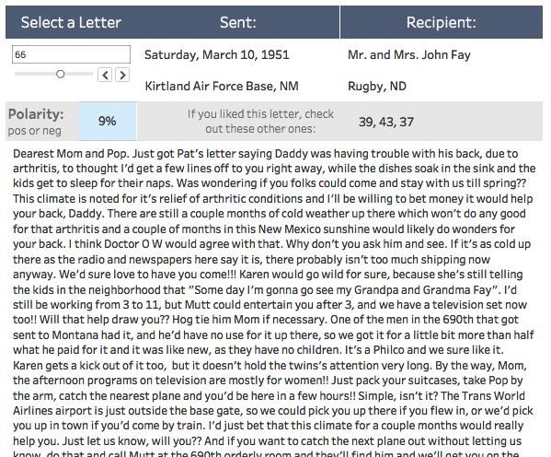
Notes:
2:45

Slide 7
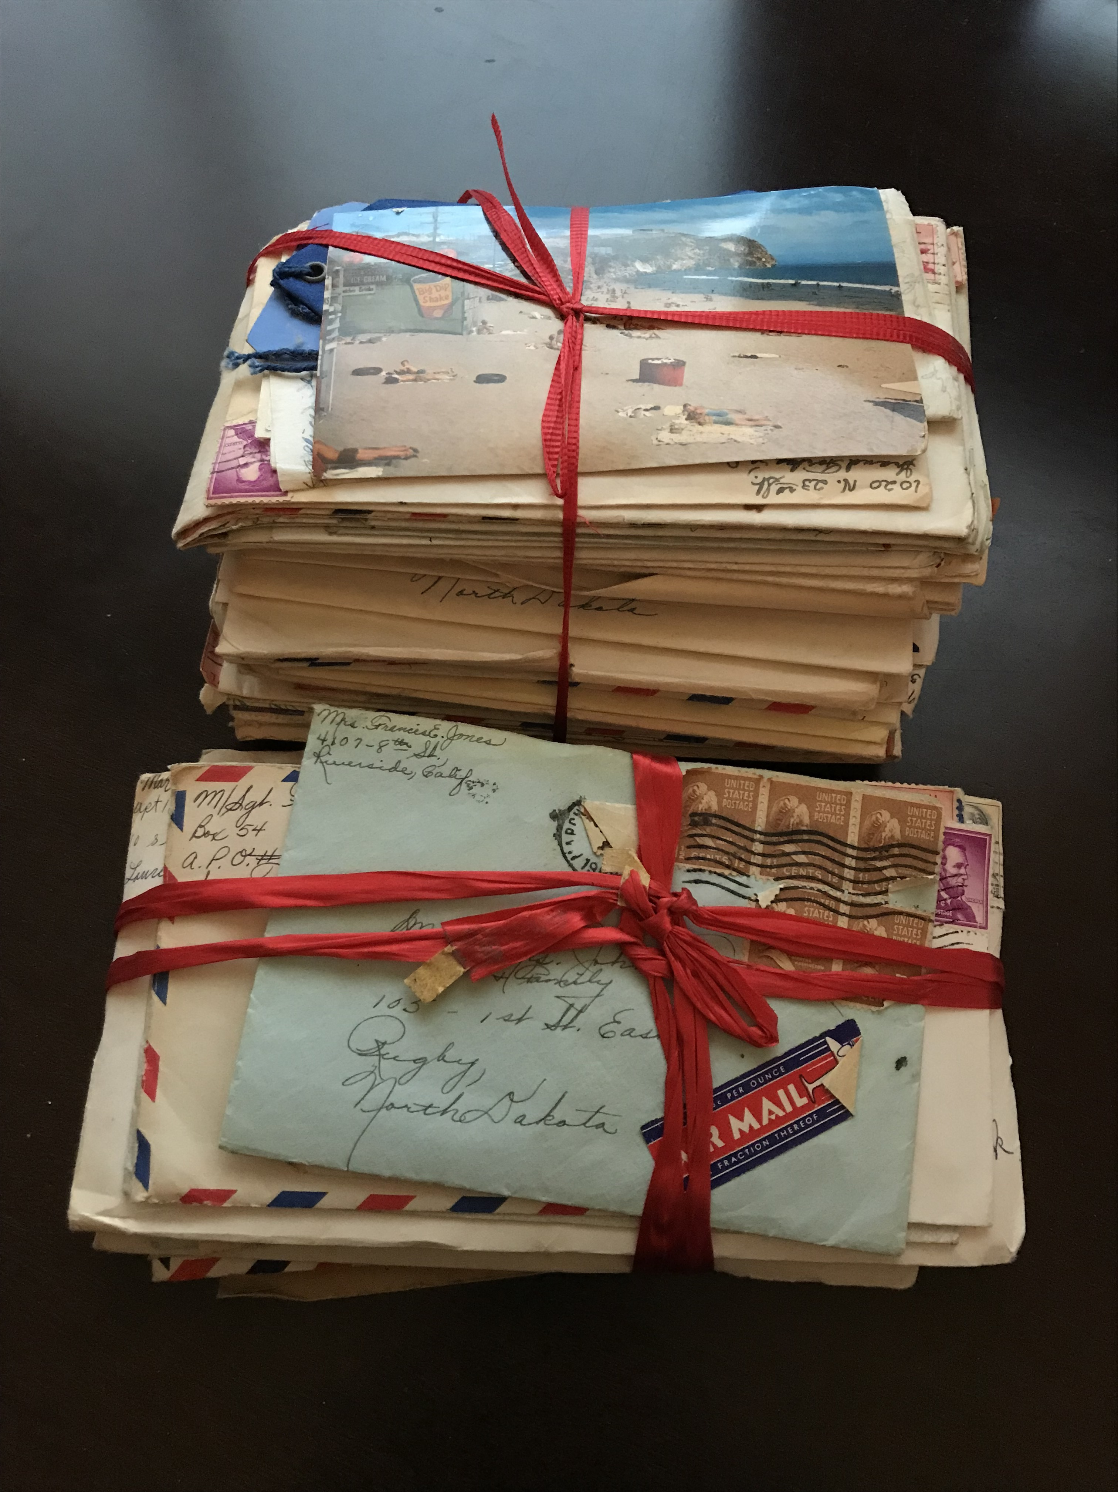
Next Steps
Complete the Dataset
Scan, transcribe, and analyze remaining 300 letters
Improve Recommender
Use clustering and advanced NLP to filter and recommend letters by topic (including proper names) and sentiment
Streamline Transcription
Investigate transcription methods with eye toward
replicability of this project by other families
Notes:
3:00 Though these skills have a lot of business applications, the end user of this product is really my family.

Slide 8
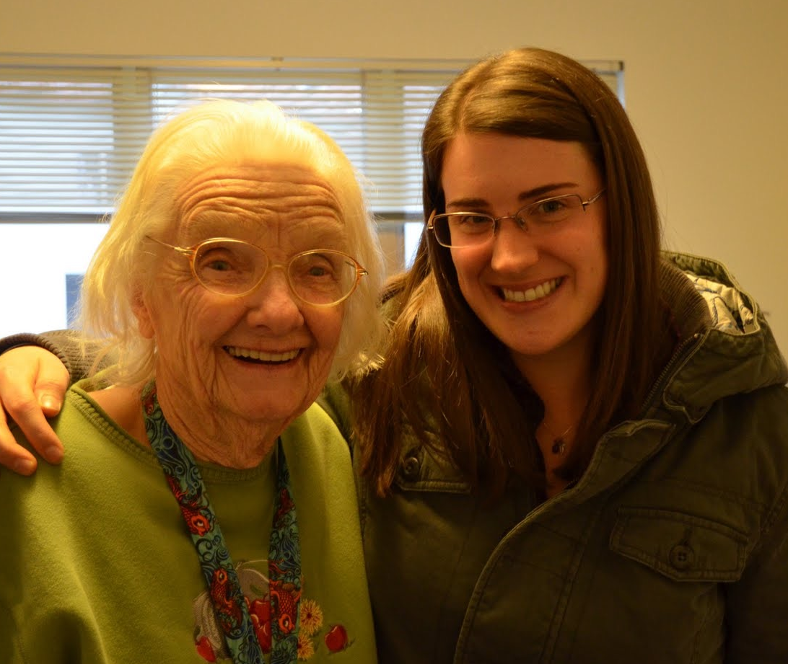
Thanks!
“It's some job to raise a family as big as yours is. Wonder if any of us will do nearly as well with our families as you have done with yours.”
Letter to her parents for their 31st anniversary June 3, 1952
Elizabeth Jones | Francis Jones | Project Files | Map and Recommender (Tableau) | Slide Template | Batch Geocode
Notes:
3:20 I’ll close with a quote that reminded me that the way we look at the generations ahead of us is just like how they looked at the generation ahead of them. This quote inspired me to continuing to build out this project and make meaning of the legacy she left behind. Thank you.

Slide 9
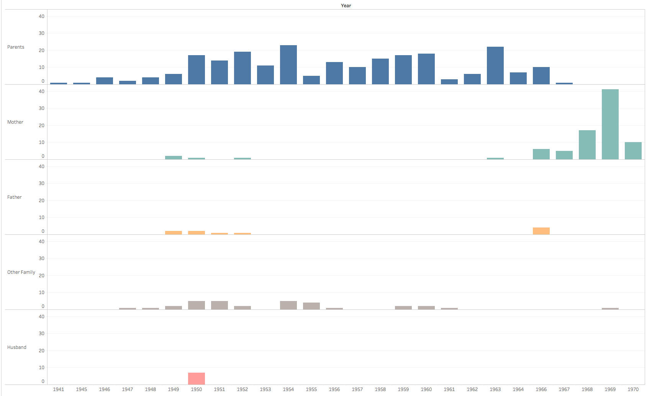
Parents
Mother
Father
Other Fam
Husband
Notes:
OVERFLOW SLIDE

Slide 10
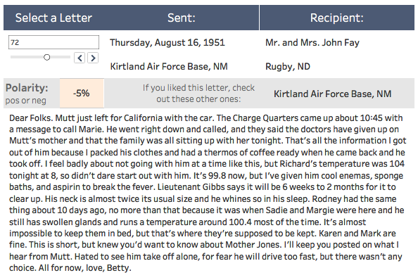
Notes:
OVERFLOW SLIDE. The one negative letter

Slide 11
362 letters
89%
50 transcribed
from 1941 to 1970
written to her parents
for this project (so far!)
Notes:
OVERFLOW SLIDE

